Slide 1
Perceptron

Slide 2
Neural Network Structures
A Neural Network＝Neurons＋Connection
Connection
Neuron
Neuron
Neural Networks Classification:
  Feed forward NNs：no feedback connection
  Recurrent NNs：have feedback connection

Slide 3
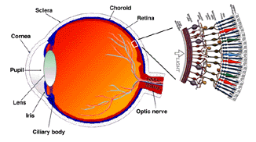
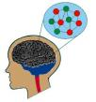
Neural Networks
FNNs: Feed forward NNs
  Recurrent NNs
RNNs：have feedback connection

Slide 4
Neural Networks
Feed forward NNs
  Recurrent NNs

Slide 5
Neural Networks
How to use NN in computer?

Slide 6


Artificial Neural Networks
Computer science
Mimic some intelligence behaviors

Slide 7
Feed forward NNs

Slide 8
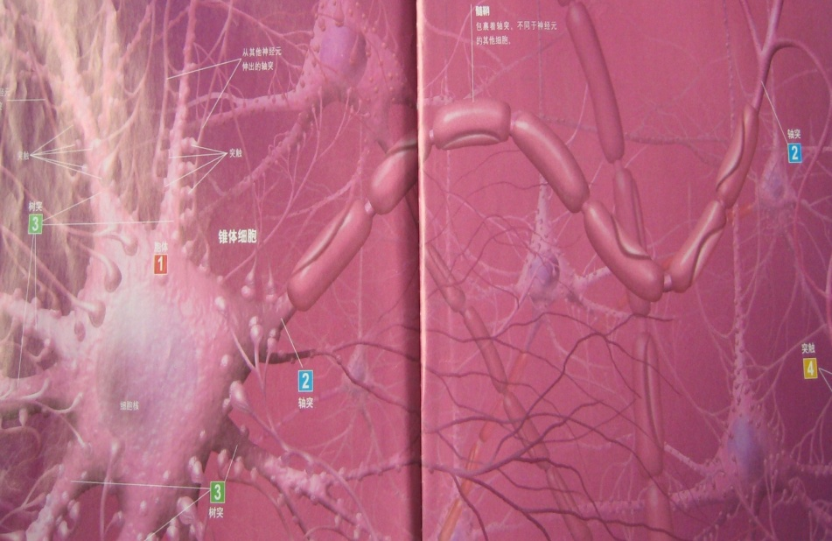
Single Neuron
。。。

Slide 9

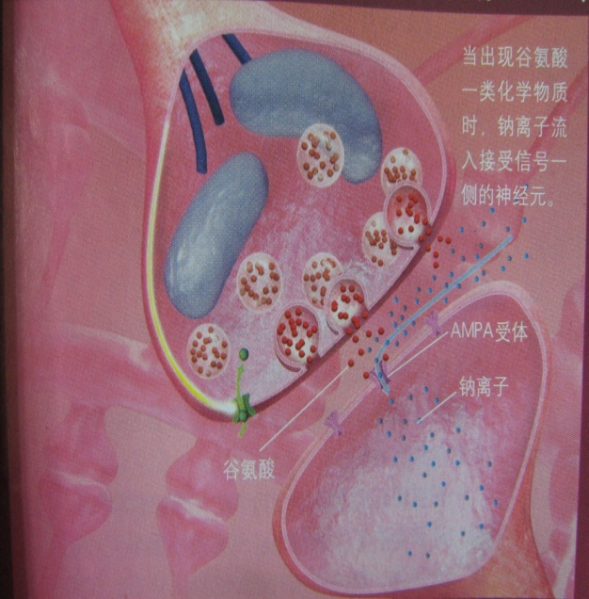






Single Neuron
。。。

Slide 10

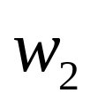


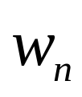
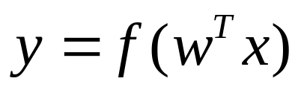
Math Model of Single Neuron
。。。

Slide 11













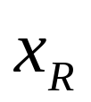
Single Layer FNNs

Slide 12







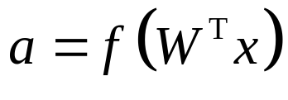






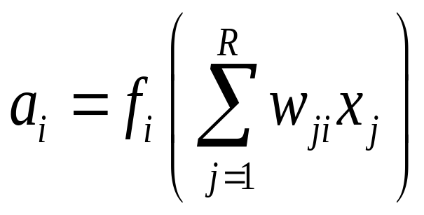








Math Model of FNNs

Slide 13














Math Model of FNNs

Slide 14
















Math Model of FNNs

Slide 15
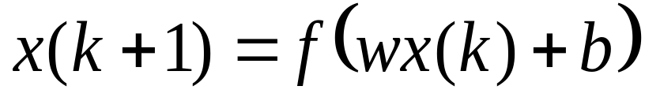
Recurrent NNs
Model：

Slide 16



Neural Networks
How to solve some practical problems?
mimic some intelligent behaviors
Using Neural Network Models

Slide 17




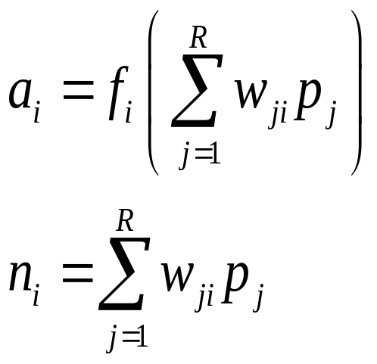





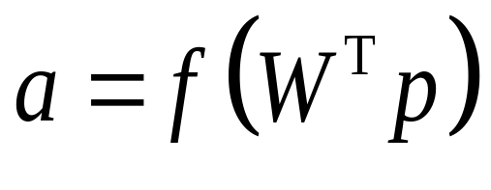



Single Layer FNNs
Math Model

Slide 18

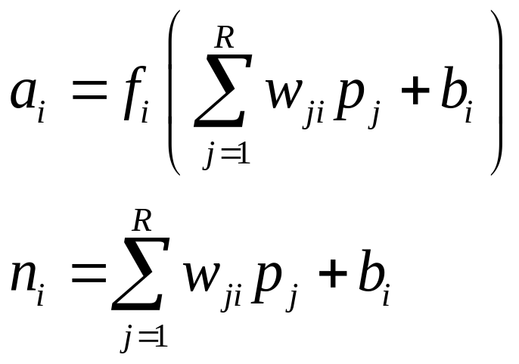


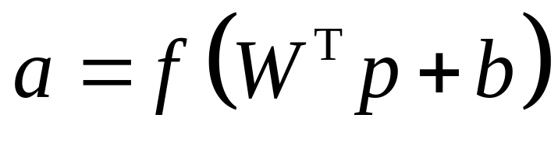
Single Layer FNNs
Math Model

Slide 19
Single Layer FNNs
How to mimic intelligent behaviors?

Slide 20
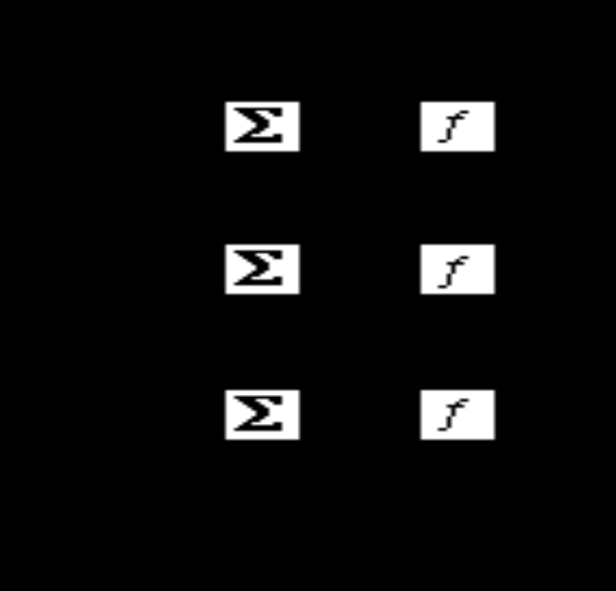
Perceptron
Frank Rosenblatt
1950’s
Frank Rosenblatt，The Perceptron: a Probabilistic Model for Information Storage and Organization in the Brain, Psychological Review, vol. 65, no. 6, 1958

Slide 21
An Intuitive Example

Slide 22
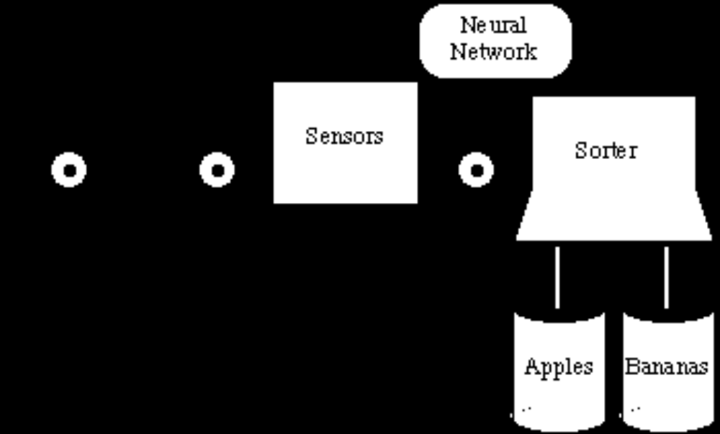
Apple/Banana Classifier

Slide 23
Perceptron
Data Classification
Data
classification
Data Set
perceptron

Slide 24
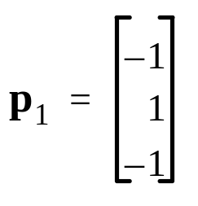
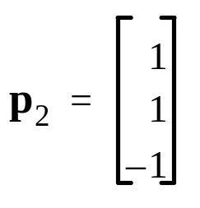
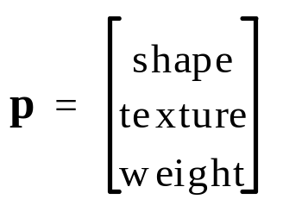
Data Preparation
Measurement
Vector
Banana
Apple
Perceptron
perceptron
Shape: {1 : round ; -1 : eliptical}
Texture: {1 : smooth ; -1 : rough}
Weight: {1 : > 1 lb. ; -1 : < 1 lb.}
1
－1

Slide 25
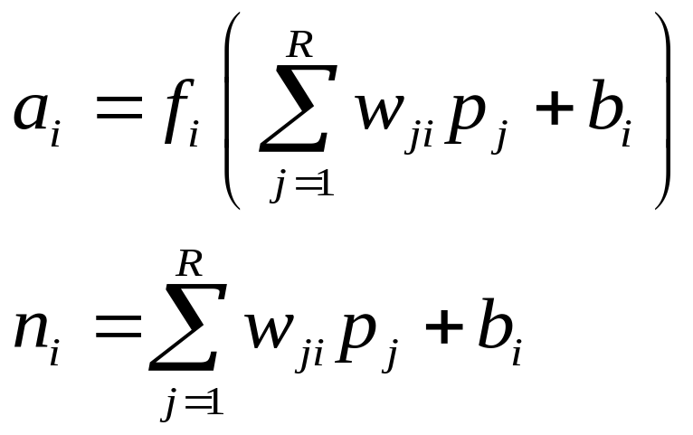
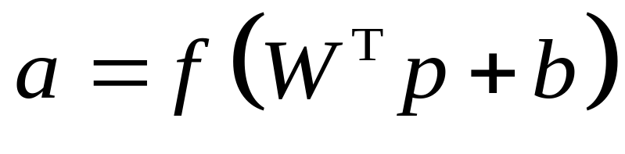
Single Layer FNNs
Math Model

Slide 26
Perceptron Design
How many inputs
How many outputs
How many neurons
How many layers
Math Model

Slide 27





Perceptron Design
shape
texture
weight
Inputs

Slide 28
Perceptron Design
Banana
Apple
Perceptron
perceptron
outputs
1
－1

Slide 29
Perceptron Design
shape
texture
weight
Neurons? Layers?

Slide 30

Perceptron Design
Neurons? Layers?
Occam's razor
Entities should not be multiplied unnecessarily

Slide 31
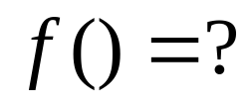

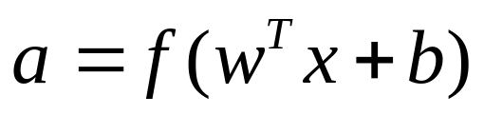
Perceptron Design
shape
texture
weight

Slide 32
Perceptron Design
Banana
Apple
shape
texture
Perceptron
perceptron
weight
1
－1

Slide 33

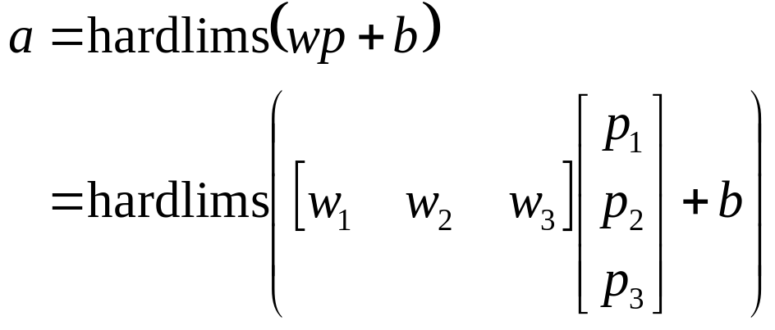



Perceptron Design

Slide 34
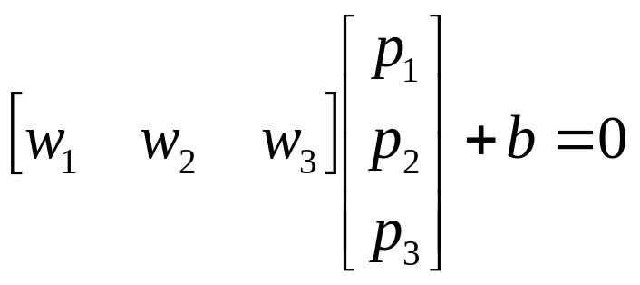
Perceptron Design
Decision plan

Slide 35
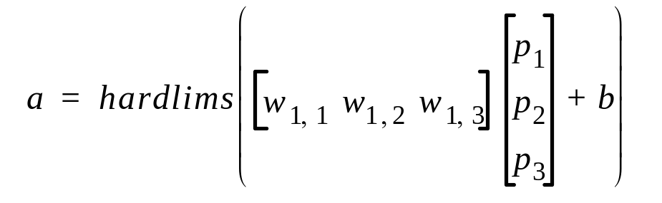
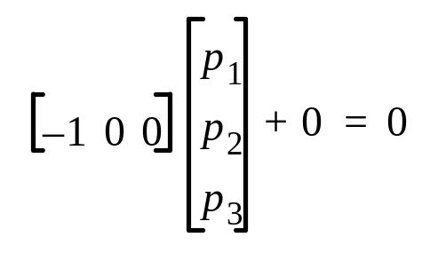
Decision Plan
Banana
Apple

Slide 36


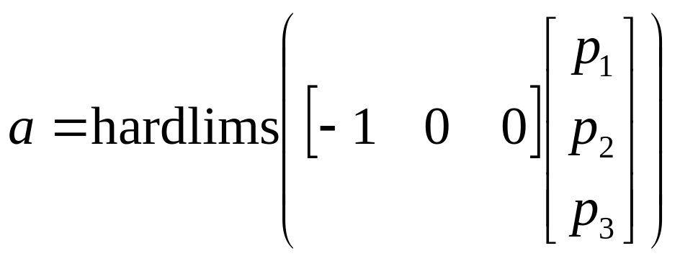

Perceptron Design

Slide 37


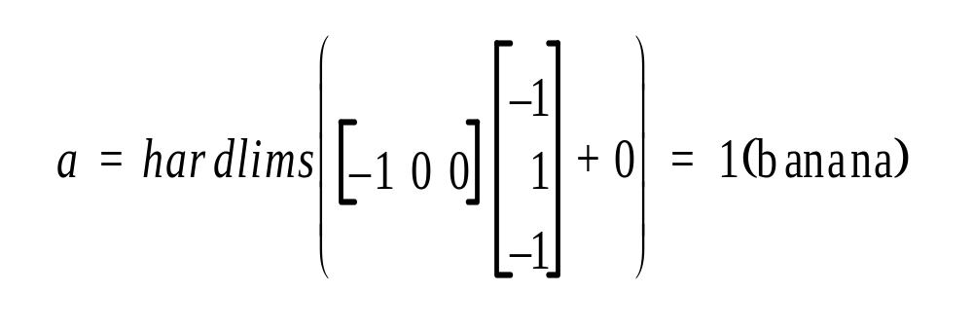
Check
Banana
Banana

Slide 38

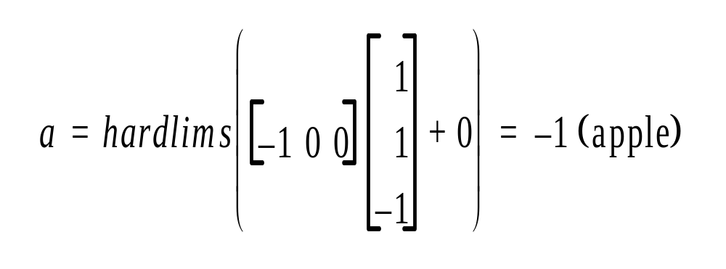
Check
Apple
apple

Slide 39

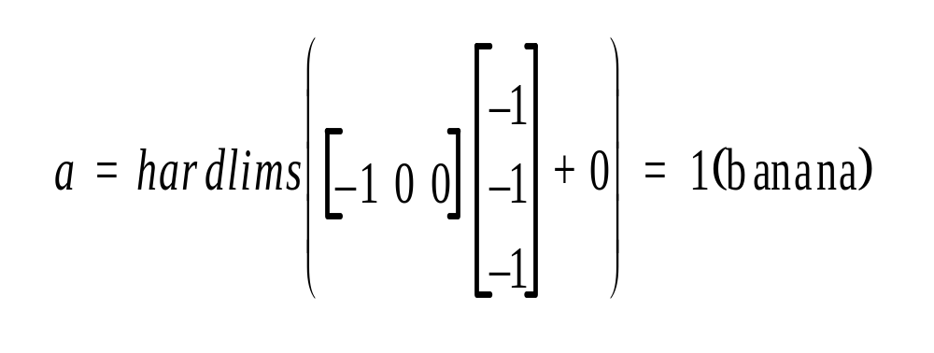
Check
shape
“Rough” Banana:
texture
Banana
weight
Banana

Slide 40
Banana:
Apple:
“Rough” Banana:

Slide 41

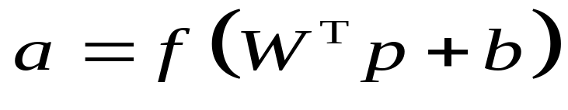
Perceptron
Math Model
How to adjust W by learning?

